Slide 1
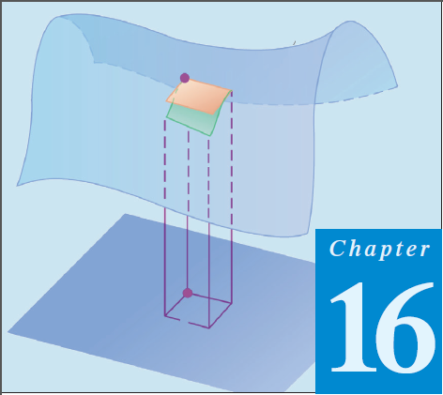
12
Thomas Calculus 12th (Chapter 16)
Calculus 9rd, Dale Varberg, Edwin Purcell and Steve Rigdon (C.14)
INTEGRATION IN VECTOR FIELDS
Samuel Lukas

Slide 2
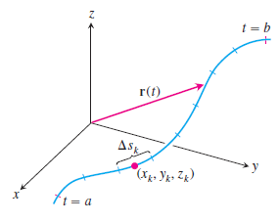
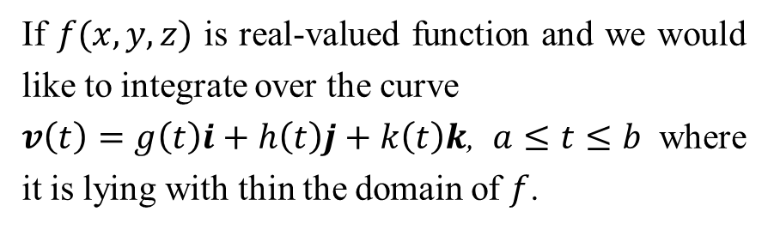
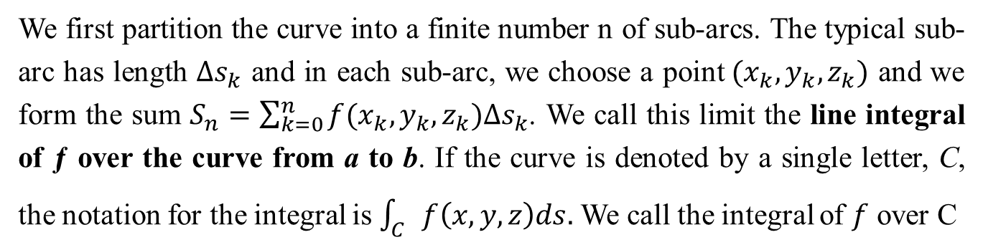
Line Integrals
If $f(x,y,z)$ is real-valued function and we would like to integrate over the curve
$v\left(t\right)=g\left(t\right)i+h\left(t\right)j+k\left(t\right)k$, $a≤t≤b$ where it is lying with thin the domain of $f$.
We first partition the curve into a finite number n of sub-arcs. The typical sub-arc has length $∆s_{k}$ and in each sub-arc, we choose a point$(x_{k},y_{k},z_{k})$ and we form the sum $S_{n}=\sum_{k=0}^{n}{f(x_{k},y_{k},z_{k})∆s_{k}}$. We call this limit the line integral of ƒ over the curve from a to b. If the curve is denoted by a single letter, C, the notation for the integral is $\int_{C}{f\left(x,y,z\right)ds.}$ We call the integral of $f$ over C

Slide 3
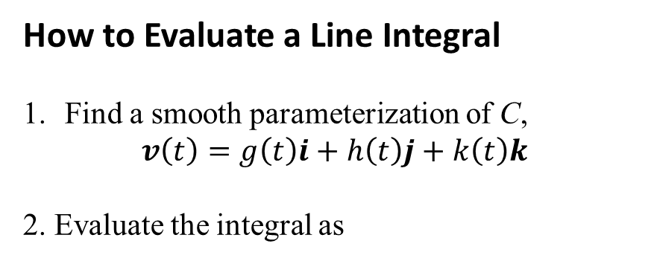
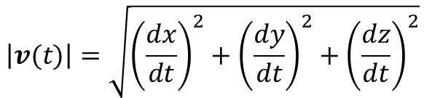
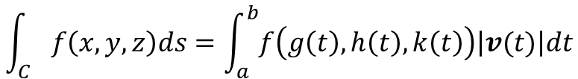
Line Integrals
How to Evaluate a Line Integral
Find a smooth parameterization of C,
$$v\left(t\right)=g\left(t\right)i+h\left(t\right)j+k\left(t\right)k$$
2. Evaluate the integral as
$$\int_{C}{f\left(x,y,z\right)ds=\int_{a}^{b}{f\left(g\left(t\right),h\left(t\right),k\left(t\right)\right)\left|v(t)\right|dt}}$$
$$\left|v(t)\right|=\sqrt{{\left(\frac{dx}{dt}\right)}^{2}+{\left(\frac{dy}{dt}\right)}^{2}+{\left(\frac{dz}{dt}\right)}^{2}}$$

Slide 4
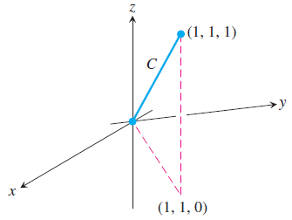




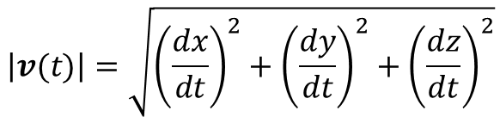


We choose the simplest parametrization of the C
$$v\left(t\right)=ti+tj+tk, 0≤t≤1$$
$$\left|v(t)\right|=\sqrt{{\left(\frac{dx}{dt}\right)}^{2}+{\left(\frac{dy}{dt}\right)}^{2}+{\left(\frac{dz}{dt}\right)}^{2}}$$
$$\left|v(t)\right|=\sqrt{{\left(1\right)}^{2}+{\left(1\right)}^{2}+{\left(1\right)}^{2}}$$

Slide 5
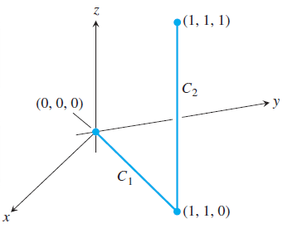





Evaluate :
$$C_{1} : v\left(t\right)=ti+tj, 0≤t≤1 →\left|v\left(t\right)\right|=\sqrt{2}$$
$$C_{2} : v\left(t\right)=i+j+tk, 0≤t≤1 →\left|v\left(t\right)\right|=1$$

Slide 6
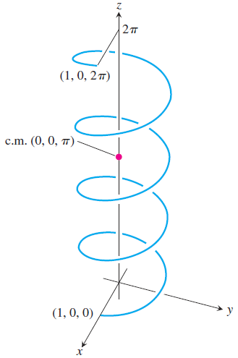






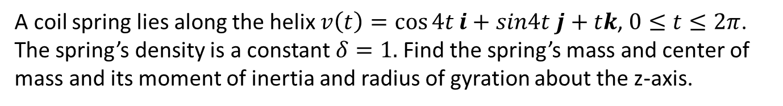
A coil spring lies along the helix $v\left(t\right)=\cos{4t}i+sin4t j+tk$, $0≤t≤2π$. The spring’s density is a constant $δ=1.$Find the spring’s mass and center of mass and its moment of inertia and radius of gyration about the z-axis.

Slide 7

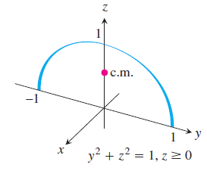










Slide 8
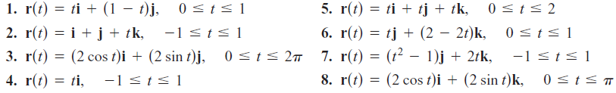
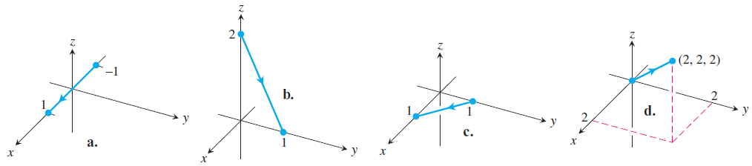
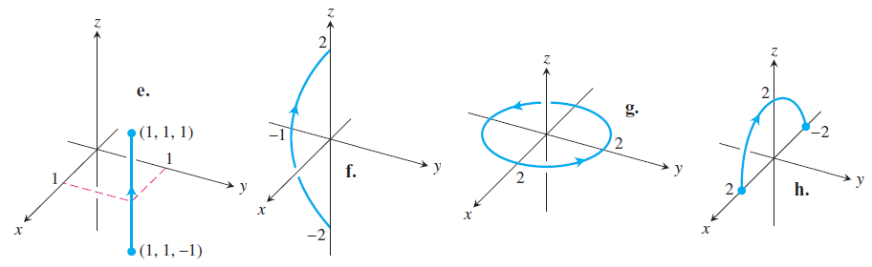
Exercises 1
Match the vector equations in Exercises 1–8 with the graphs (a)–(h) given here.

Slide 9


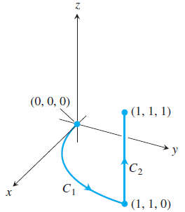
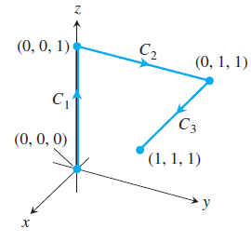
Evaluating Line Integrals over Space Curves
09.
10.
11.
12.

